Slide 1
Ascension Technology
C.A.R.
Matthew Darby, Maggie Burton, Weston Straw, Mark Du, Andrew Case, Stevie Damrel

Slide 2
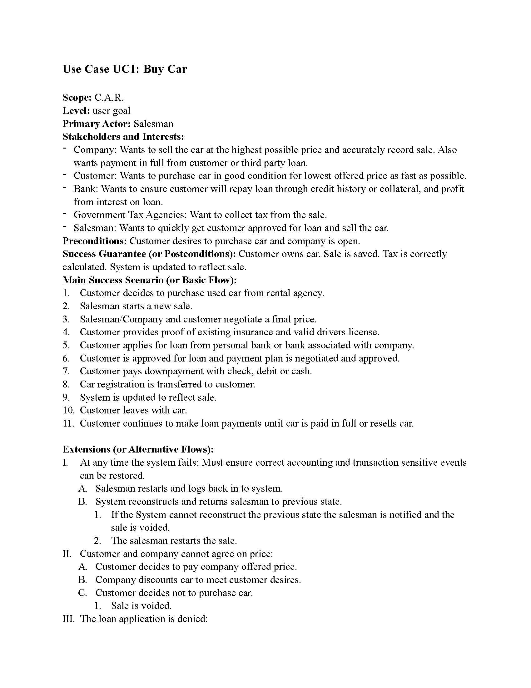
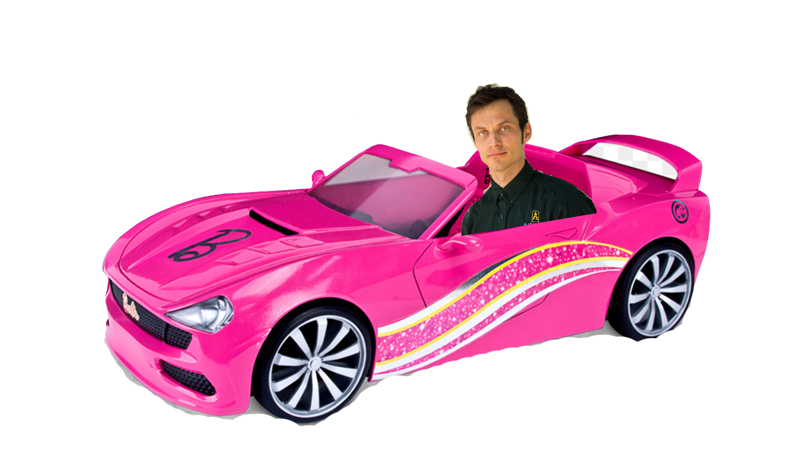

Slide 3
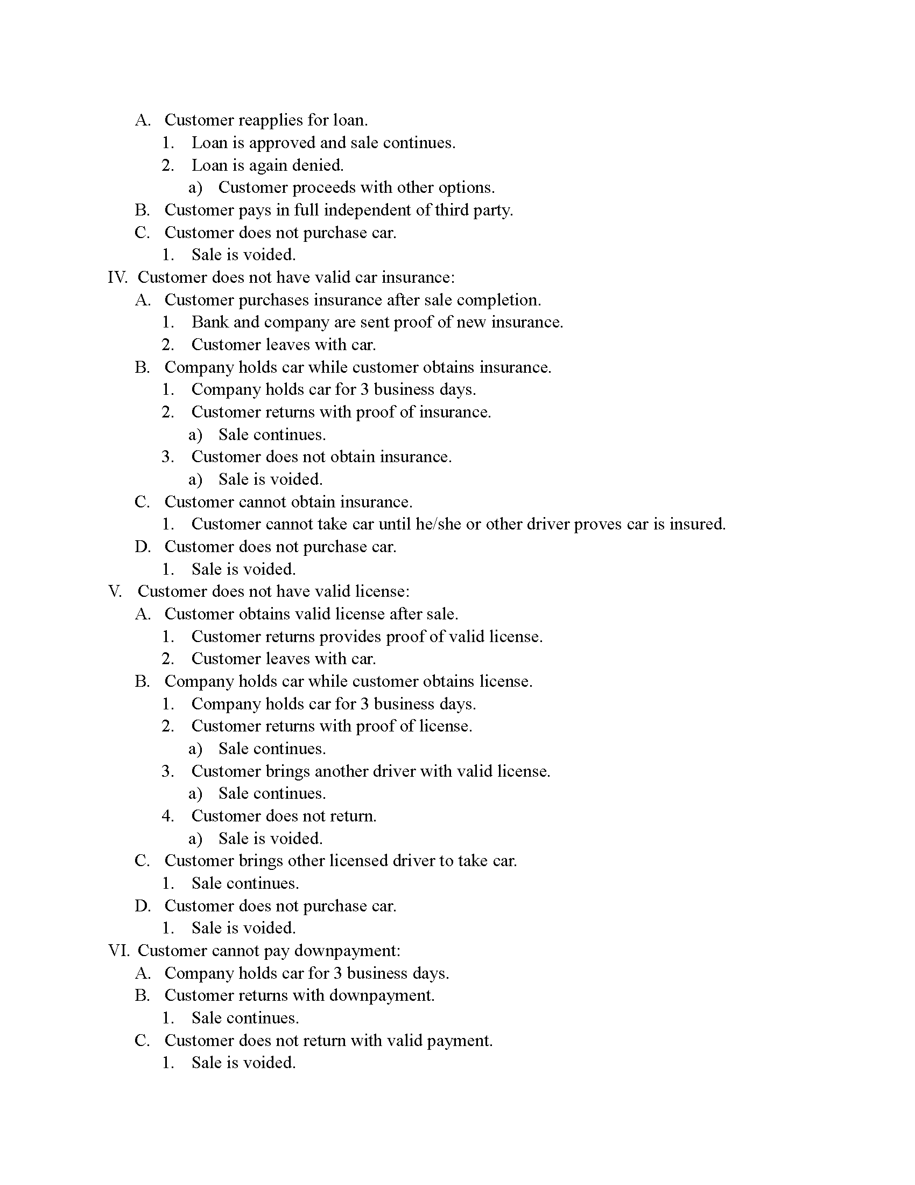


Slide 4
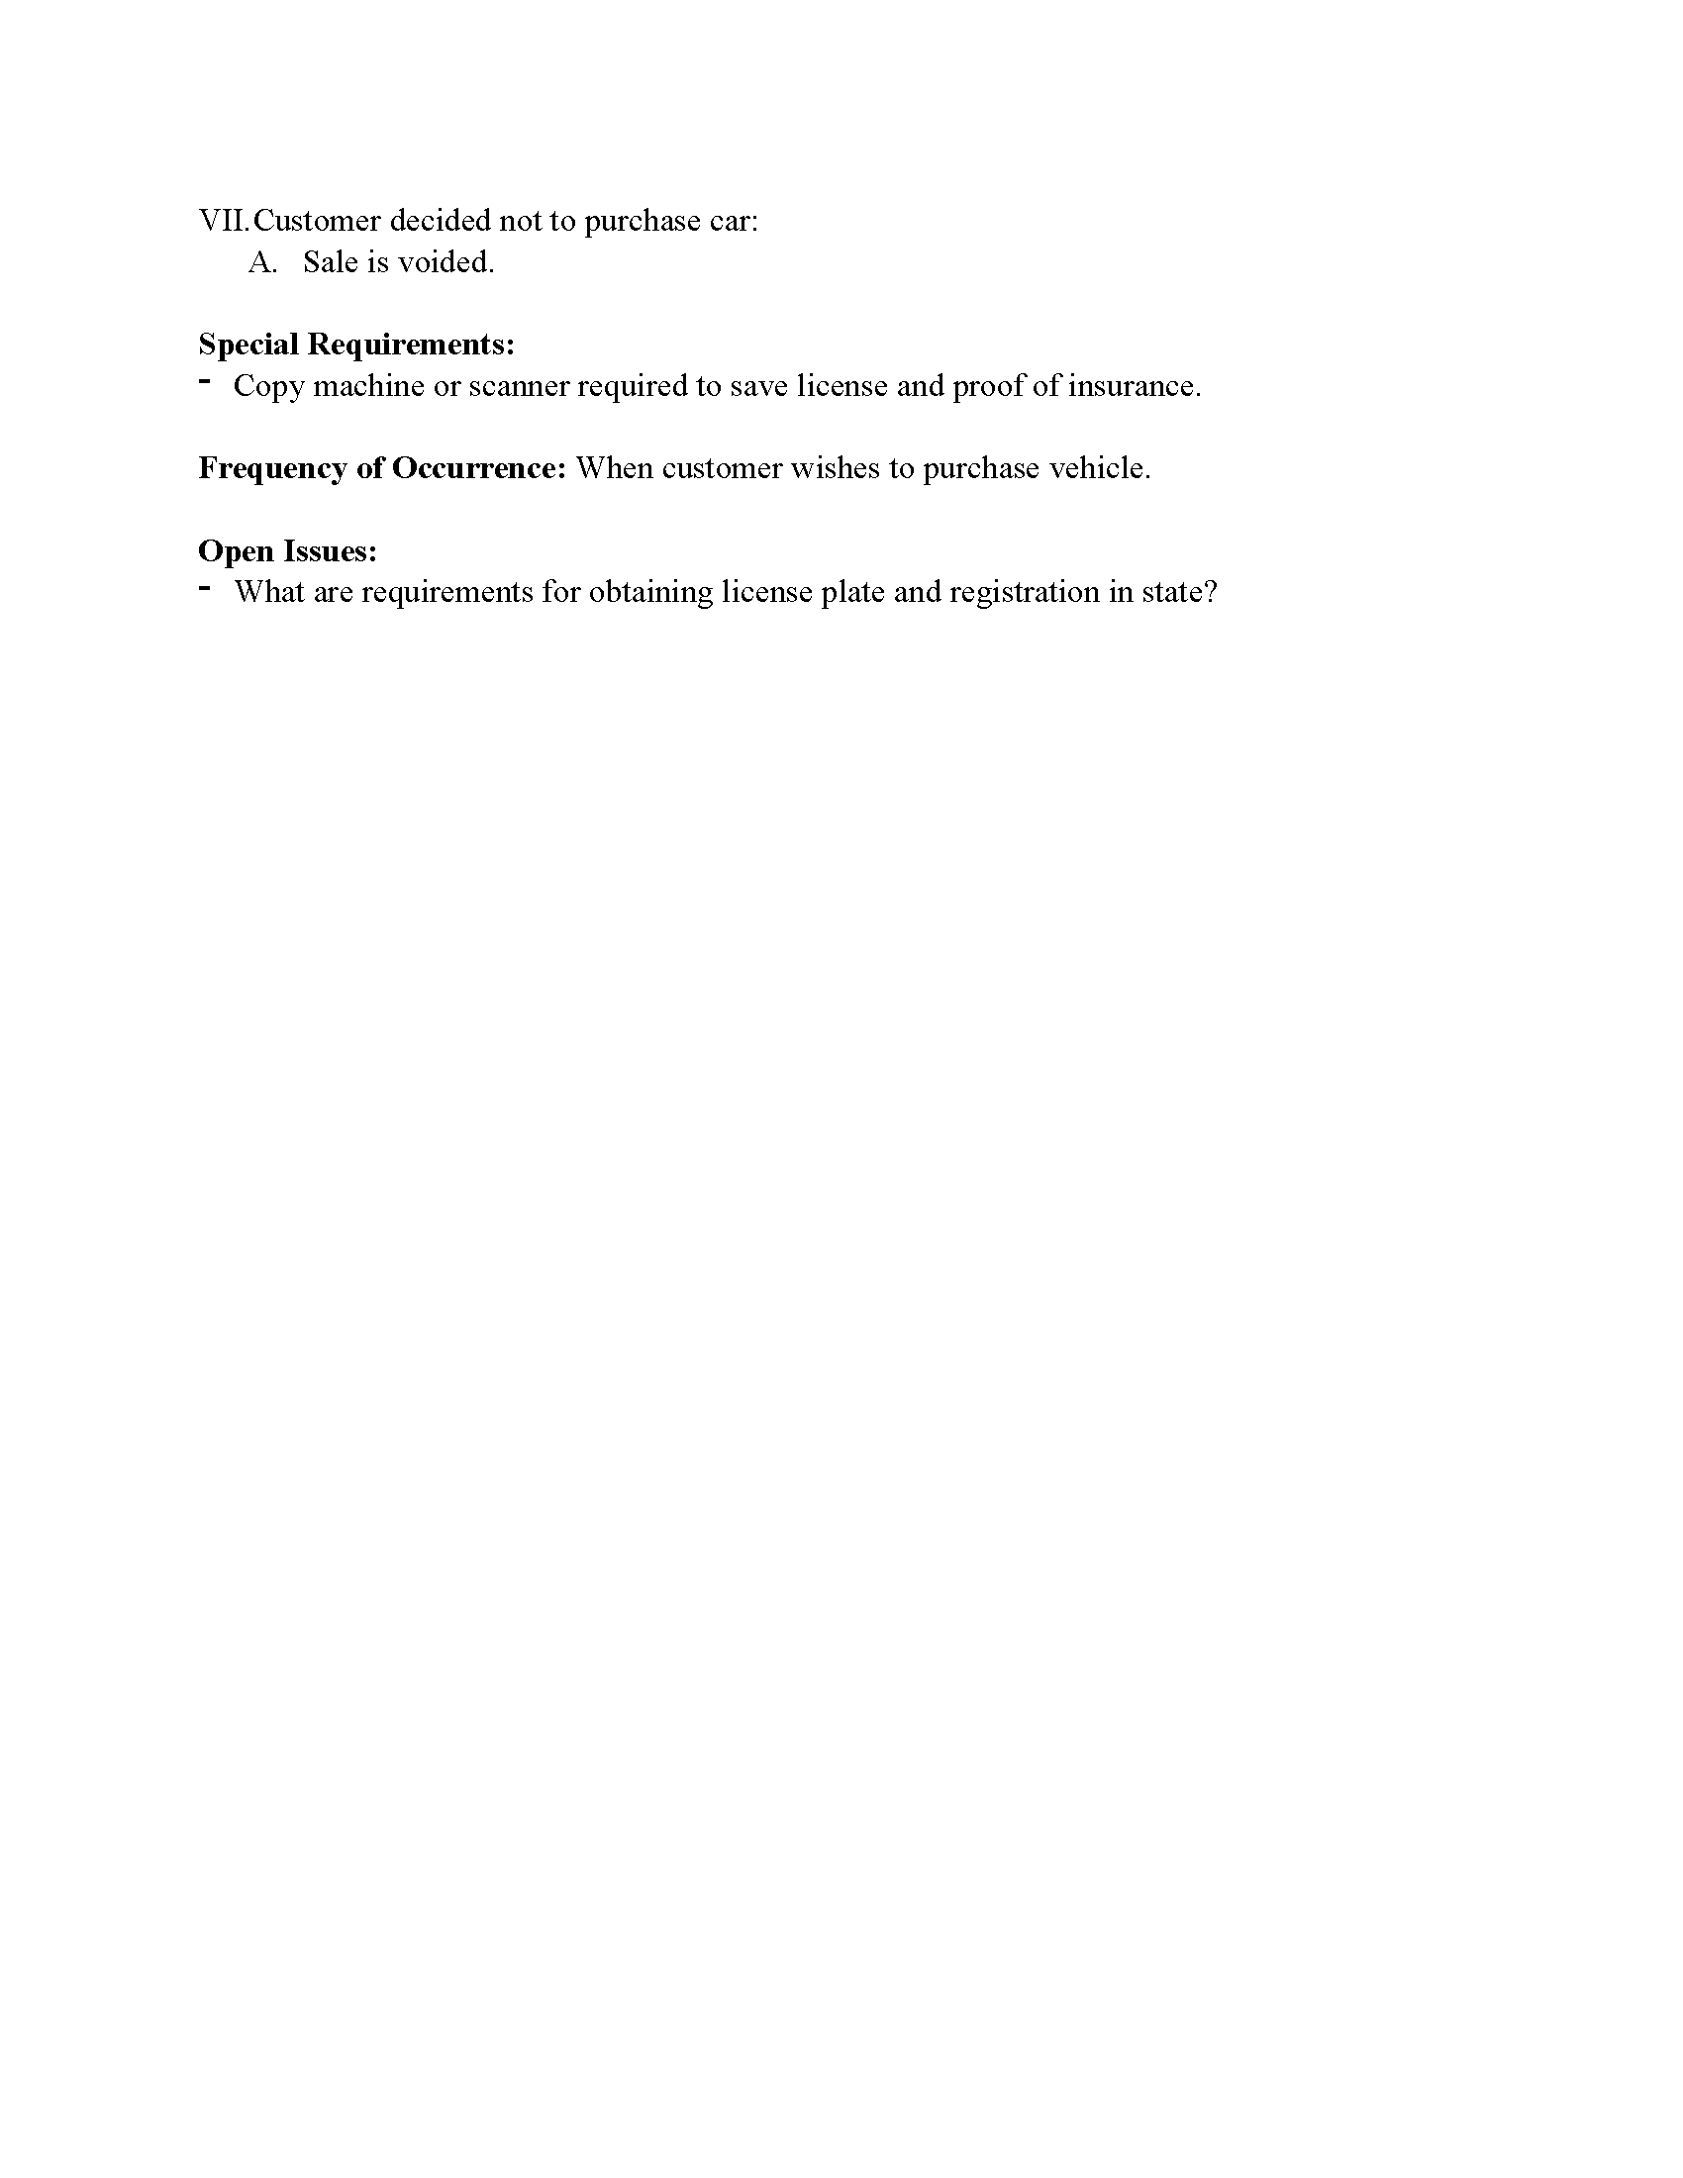
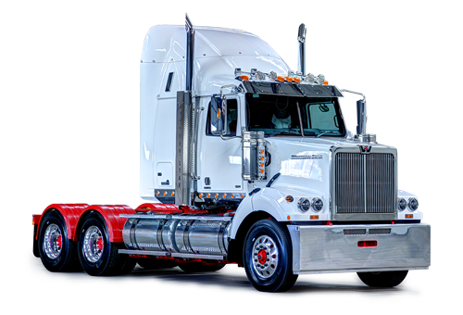


Slide 5

User is extended by
Subcontractor
Representative
Admin
One admin services zero or many receipts
Customer
A rep and an Admin have a Payroll
A catalog contains cars
An admin updates and services the catalog
A company rep will update the cars info

Slide 6
This list is not exhaustive. As with everything this list will grow and evolve as the software itself evolves.

Slide 7
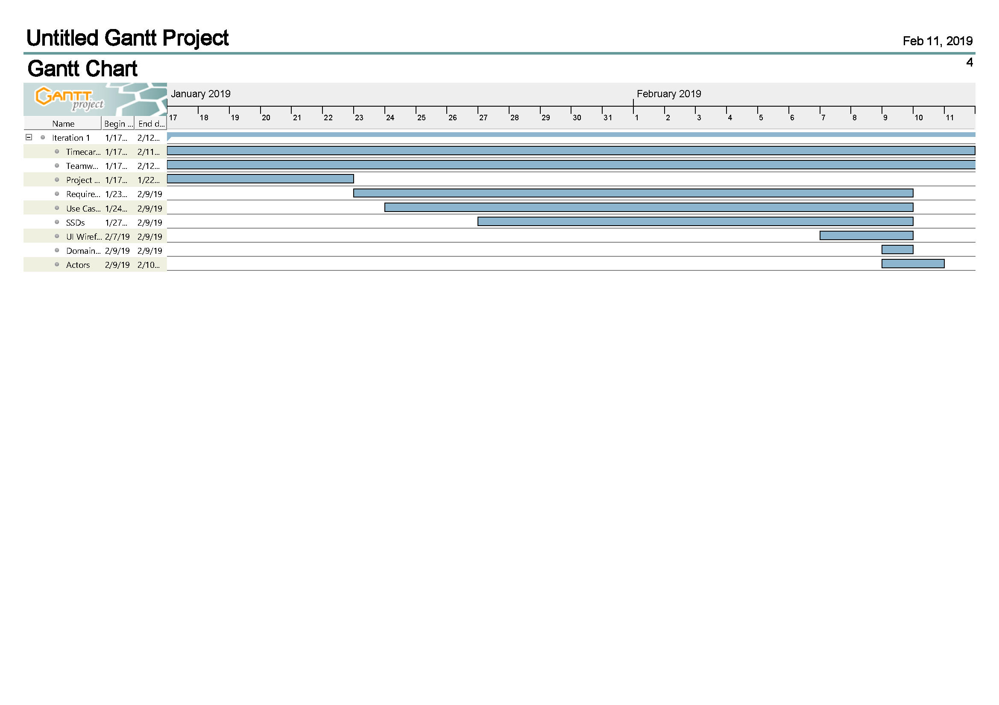
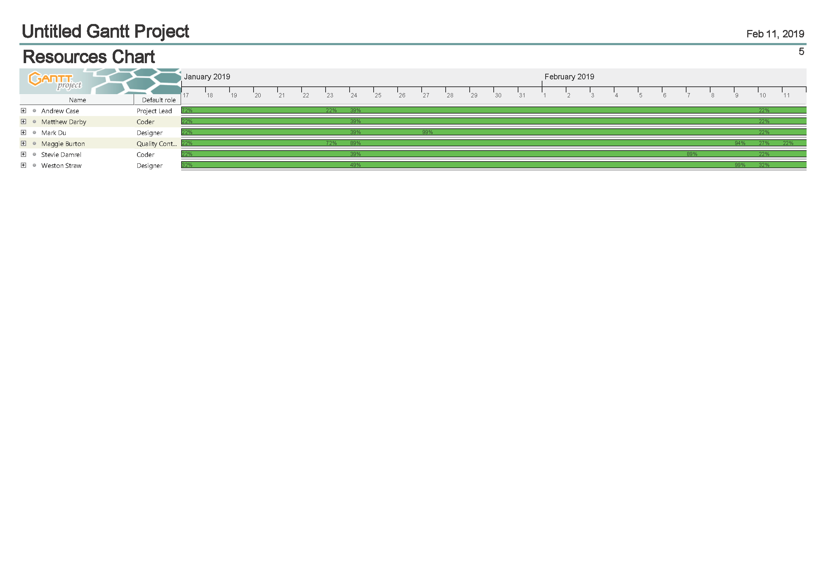

Slide 8
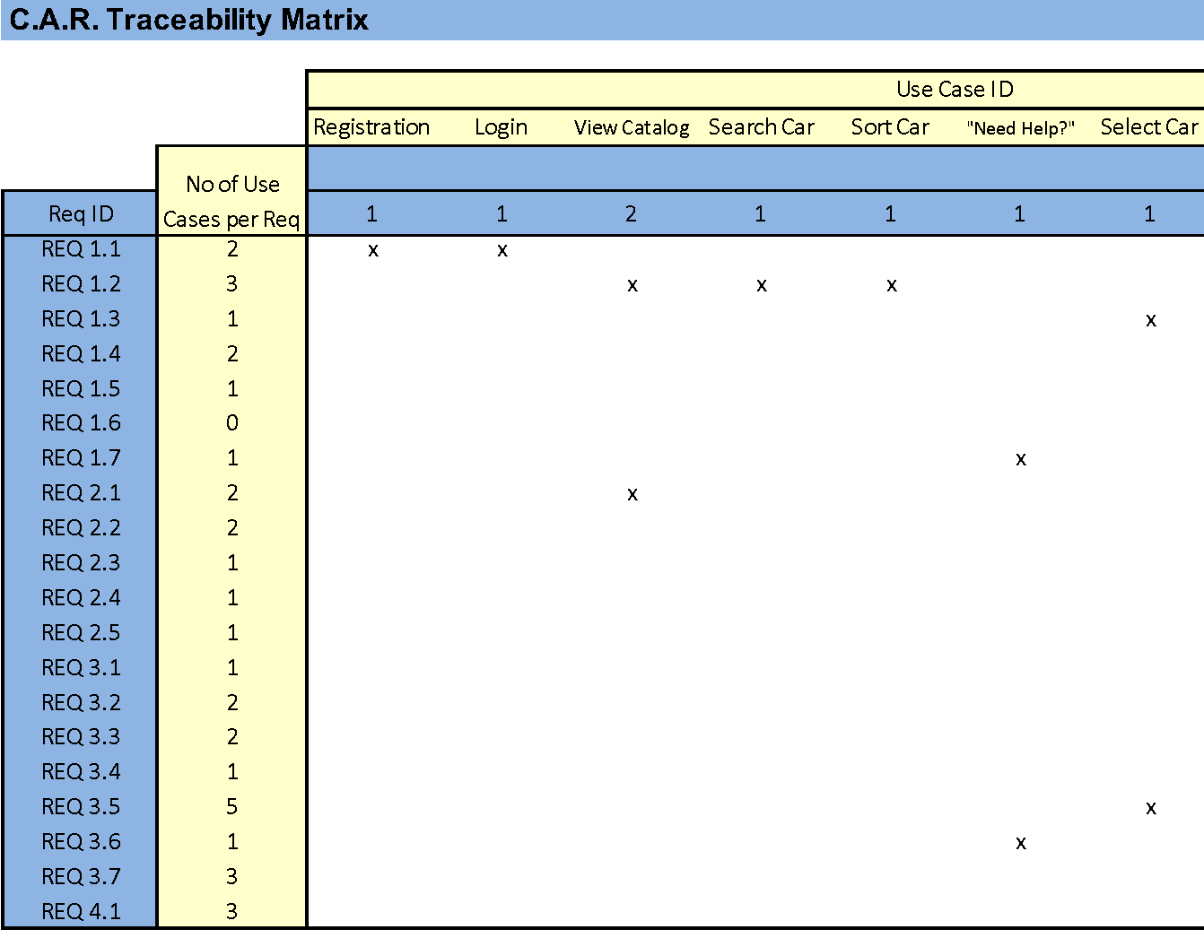
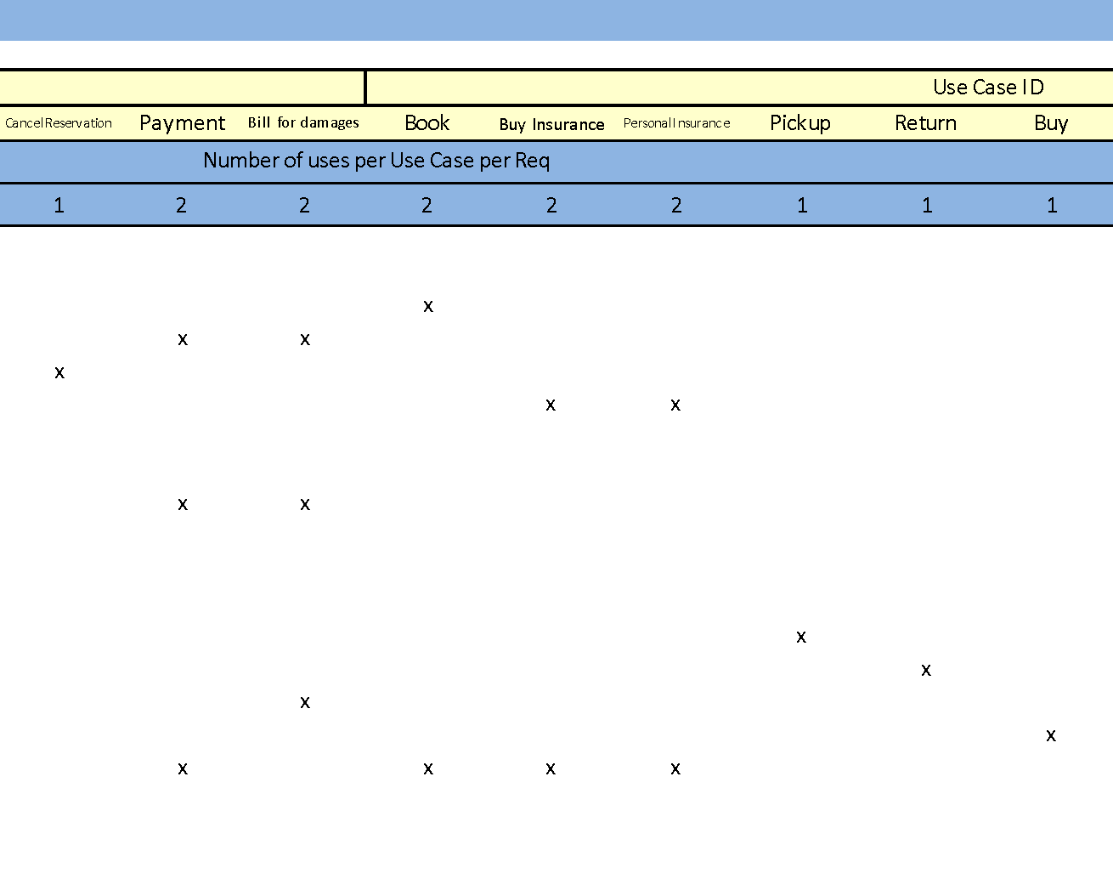
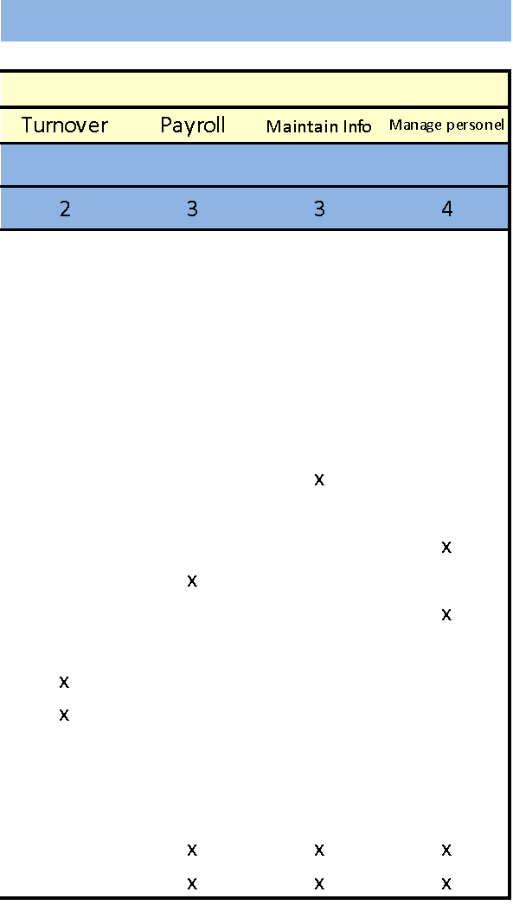

Slide 9
